Slide 1

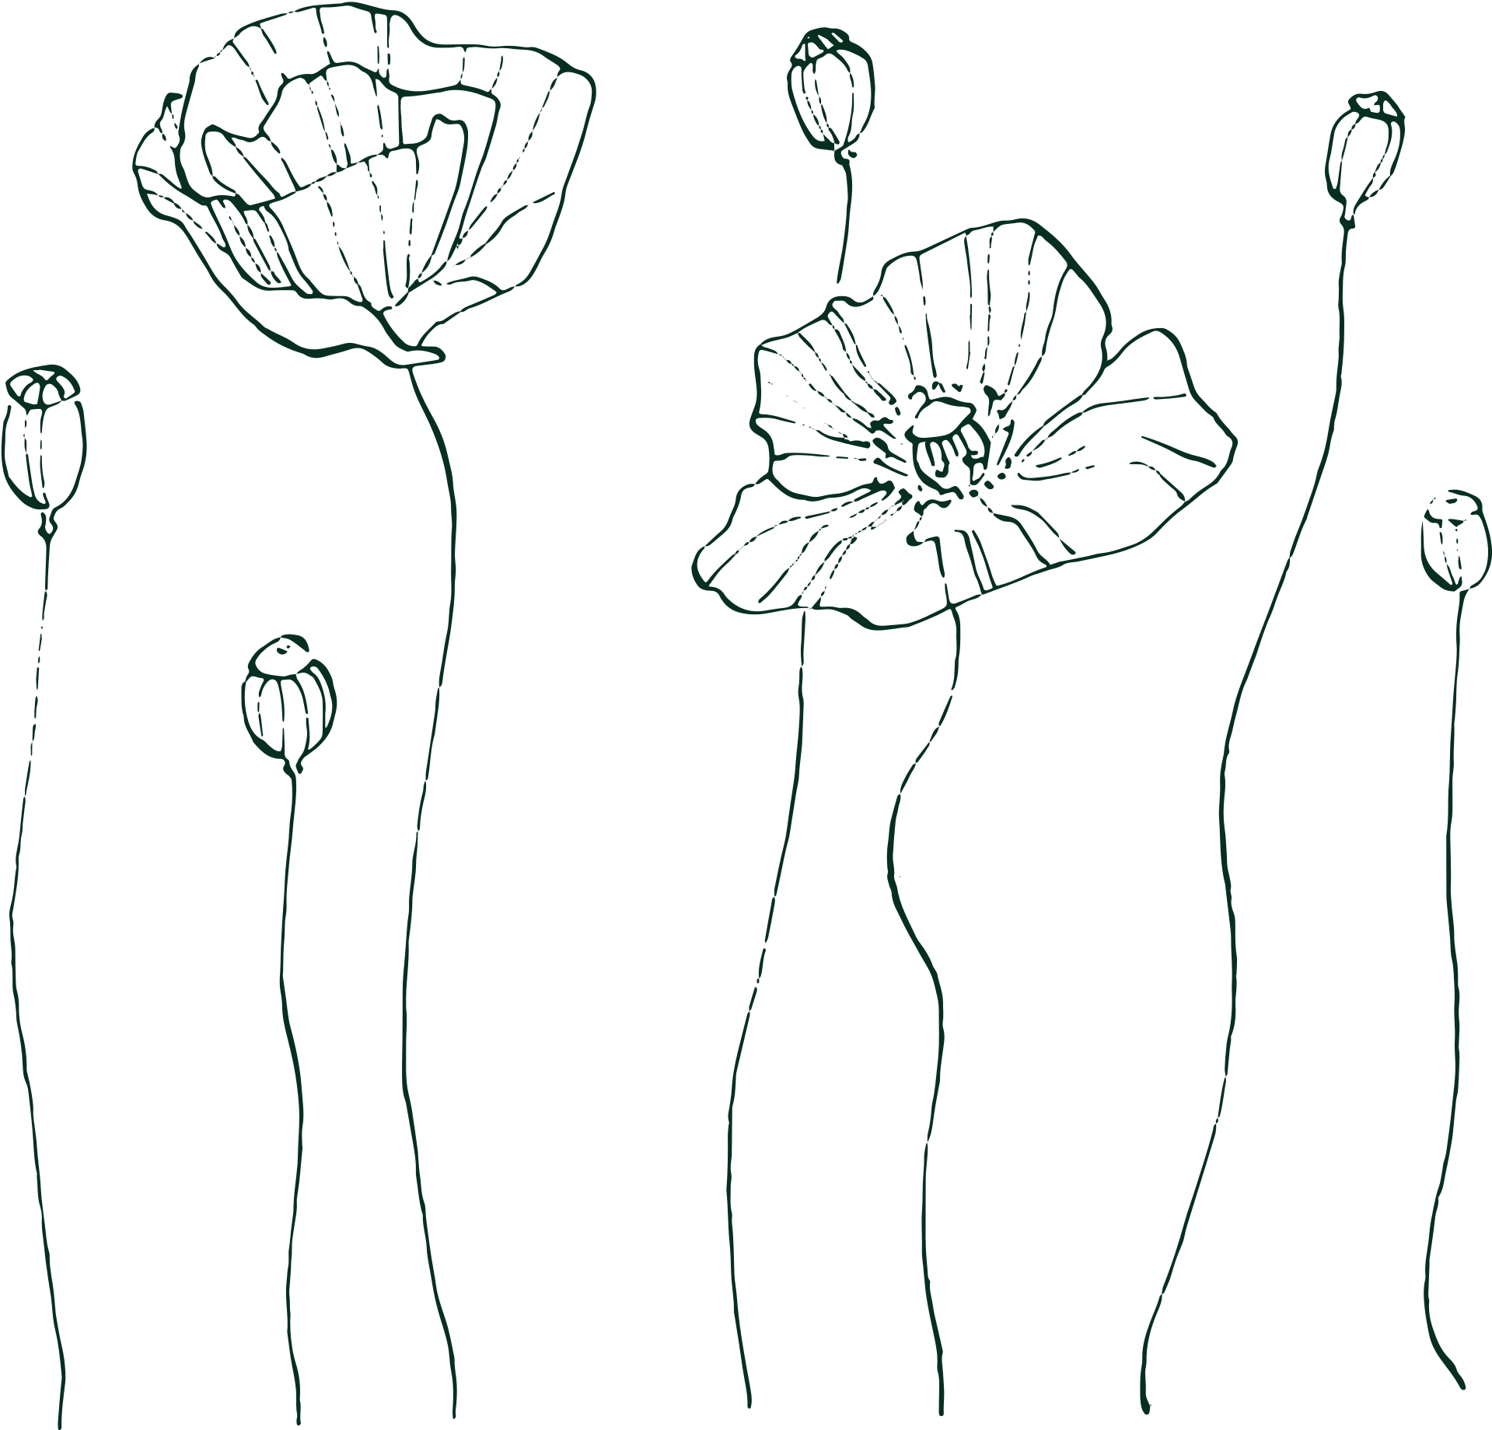







WELCOME
TO THE WEDDING OF
Amelia & William
JANUARY, 25 2023
Thank You

